Slide 1
Ion scattering by solar wind discontinuities
Zijin Zhang
Anton V. Artemyev
Vassilis Angelopoulos

Slide 2
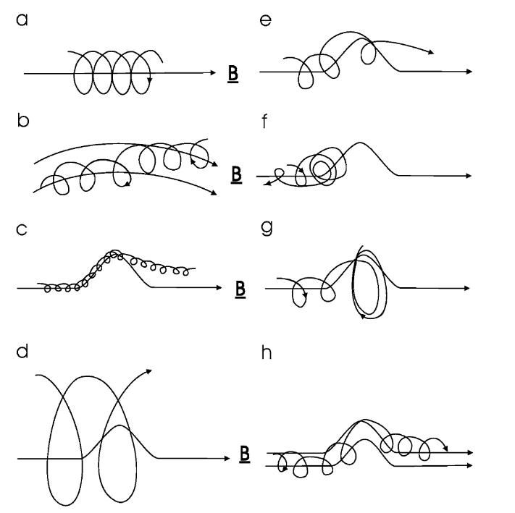
Introduction
The transport of energetic particles within the heliosphere is significantly influenced by the turbulent magnetic field present in the solar wind. However, this turbulence should not be regarded merely as a collection of random magnetic field fluctuations. Instead, the nonlinear energy cascade process results in the formation of coherent structures. These coherent structures have been shown to act as efficient particle scatterers in non-collisional plasmas (Artemyev et al. 2020).
Moraal (2013)

Slide 3
Test particle simulations
$$B=B_{0}\left(cosθ e_{z}+sinθ\left(sinφ\left(z\right) e_{z}+cosφ\left(z\right) e_{y}\right)\right)$$
with $φ\left(z\right)=βtanh\left(z\right)$
Dimensionless form of the motion equation:
$$\frac{d\left(γv\right)}{dt}=v×B,\frac{dr}{dt}=v$$
$B→B/B_{0}$ : background magnetic field magnitude
$r→r/L$ : discontinuity $L$
$t→t/Ω_{0}$ : gyroperiod
$v→v/v_{0}$ : characteristic velocity $v_{0}=Ω_{0}L$

Slide 4
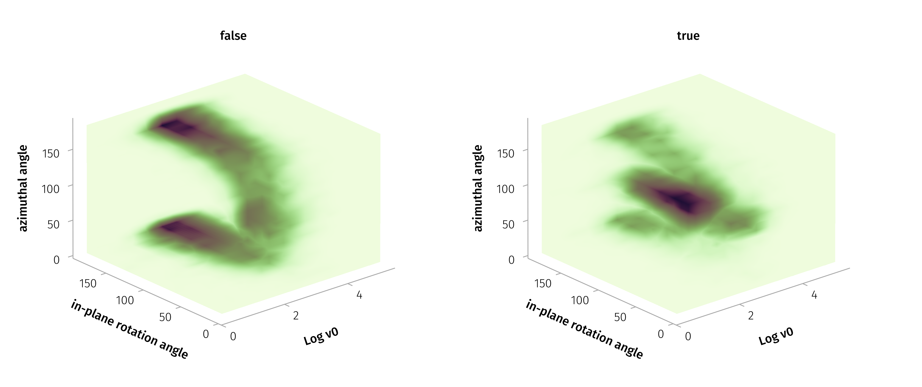
Parameters

Slide 5
$Δ\left|B\right|/\left|B\right|>0.05$ or $ω>60°$
The most probable values in the 3D distribution are a characteristic velocity ($v_{0}$) of approximately 250 km/s, a in-plane rotation angle ($ω_{in}$) about 90 degrees, and an azimuthal angle ($θ$) of around 85 degrees.

Slide 6
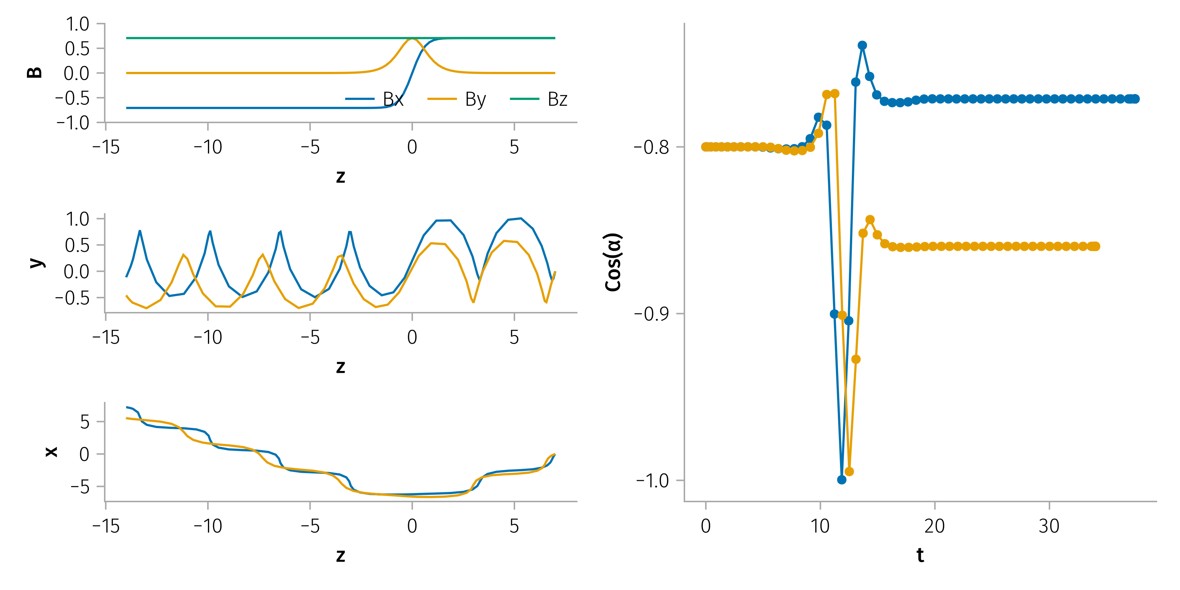
Examples of Pitch angle scattering
Example of pitch angle scattering.

Slide 7
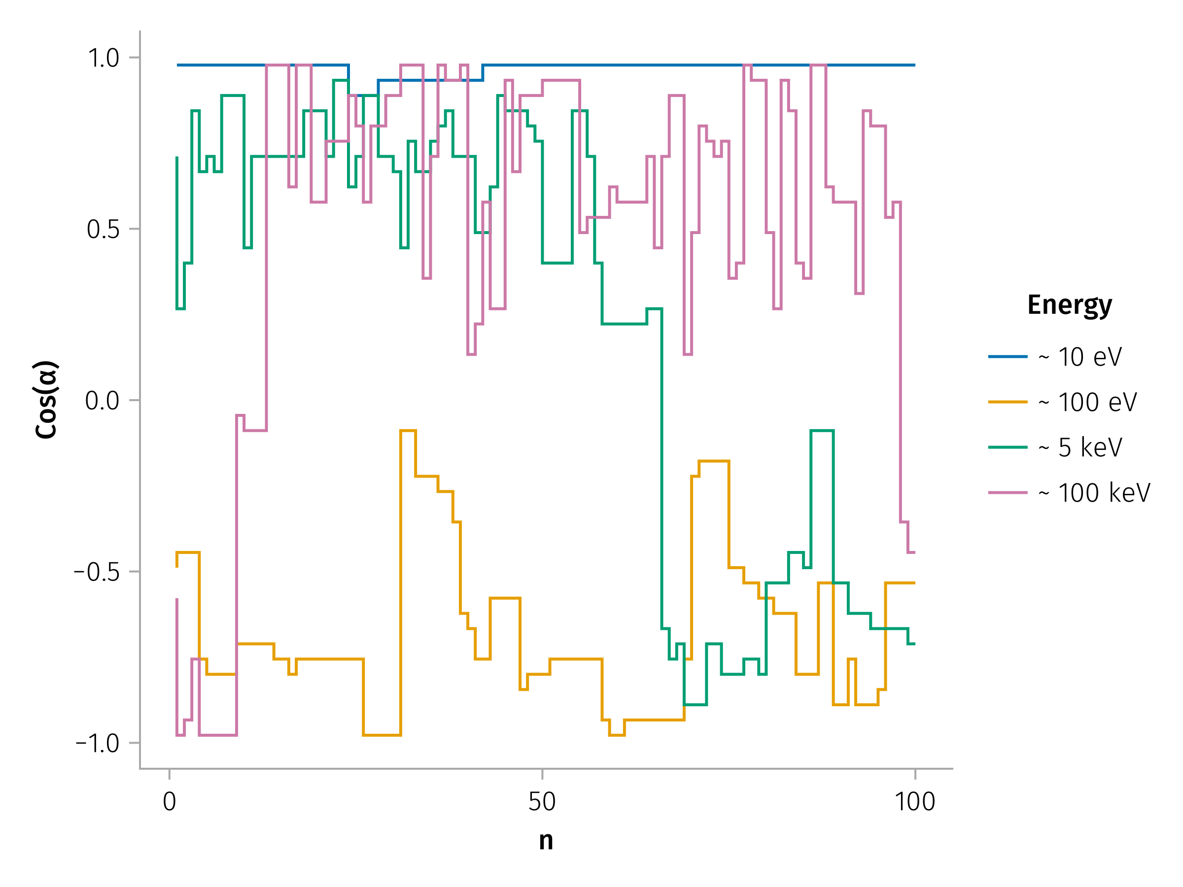
Example of multiple pitch angle scattering for different energies

Slide 8
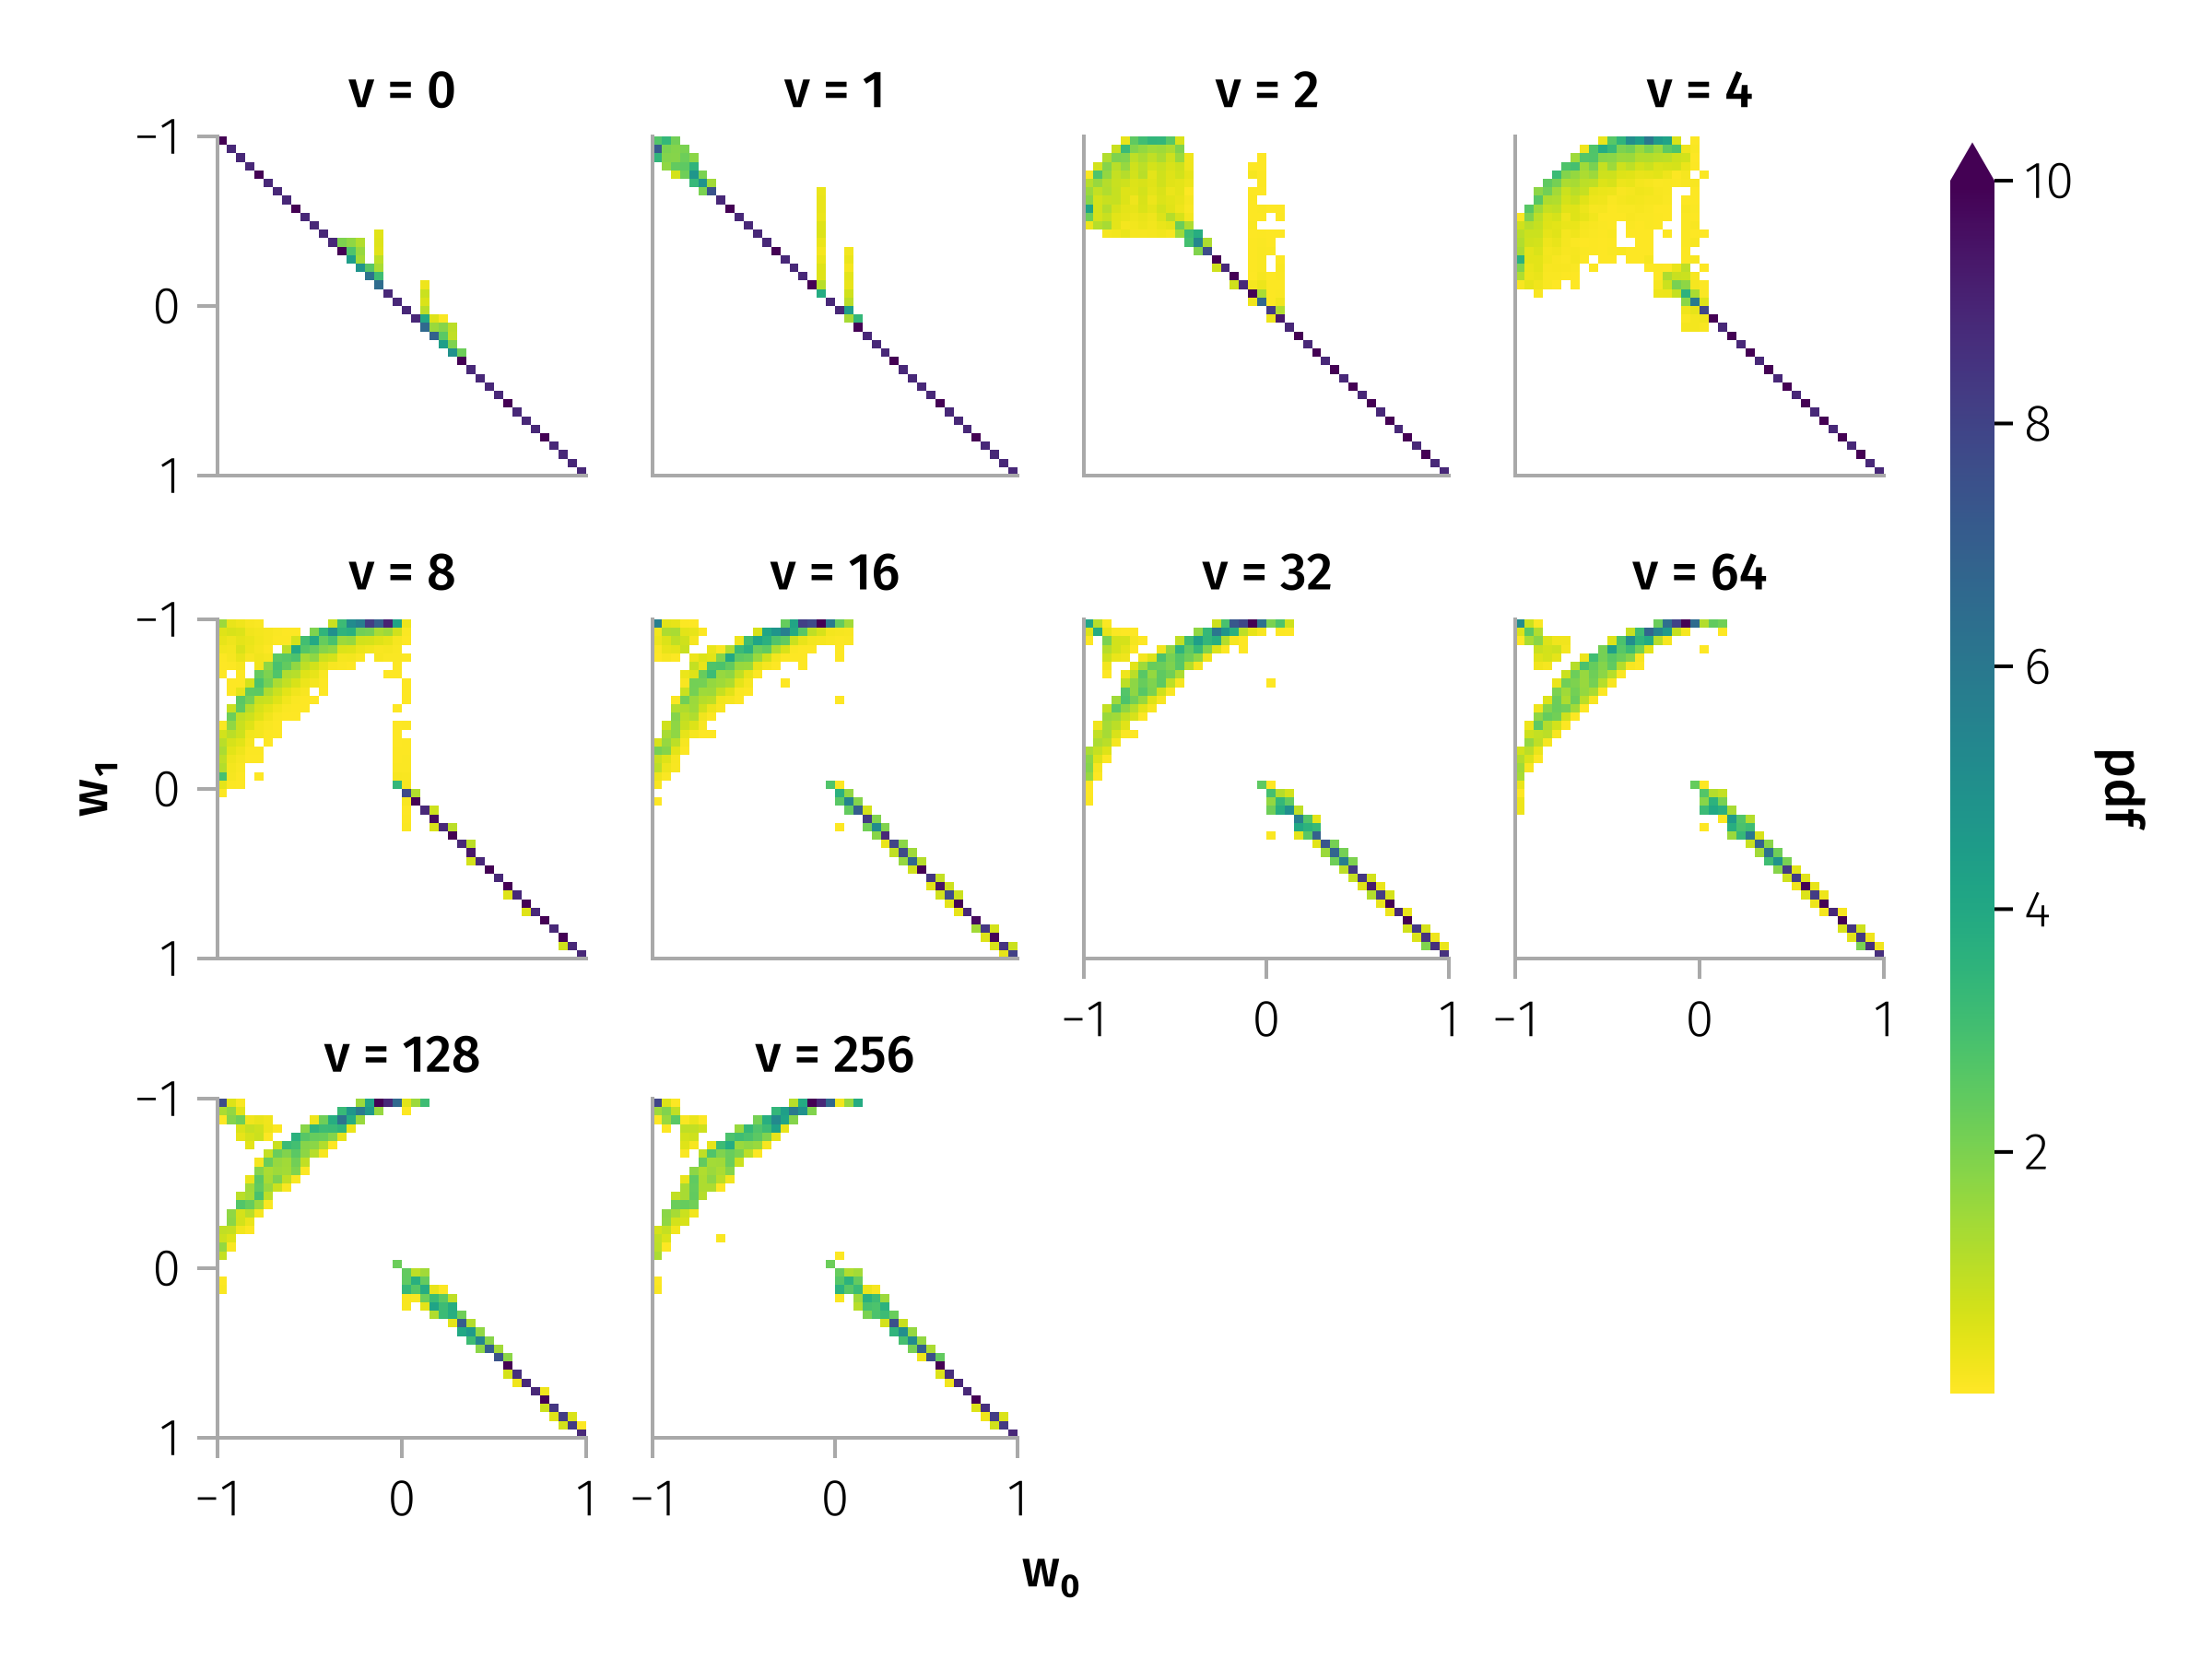
Pitch angle scattering by typical discontinuity

Slide 9
With in-plane rotation angle ($ω_{in}$) about 90 degrees, and azimuthal angle ($θ$) of around 85 degrees.

Slide 10
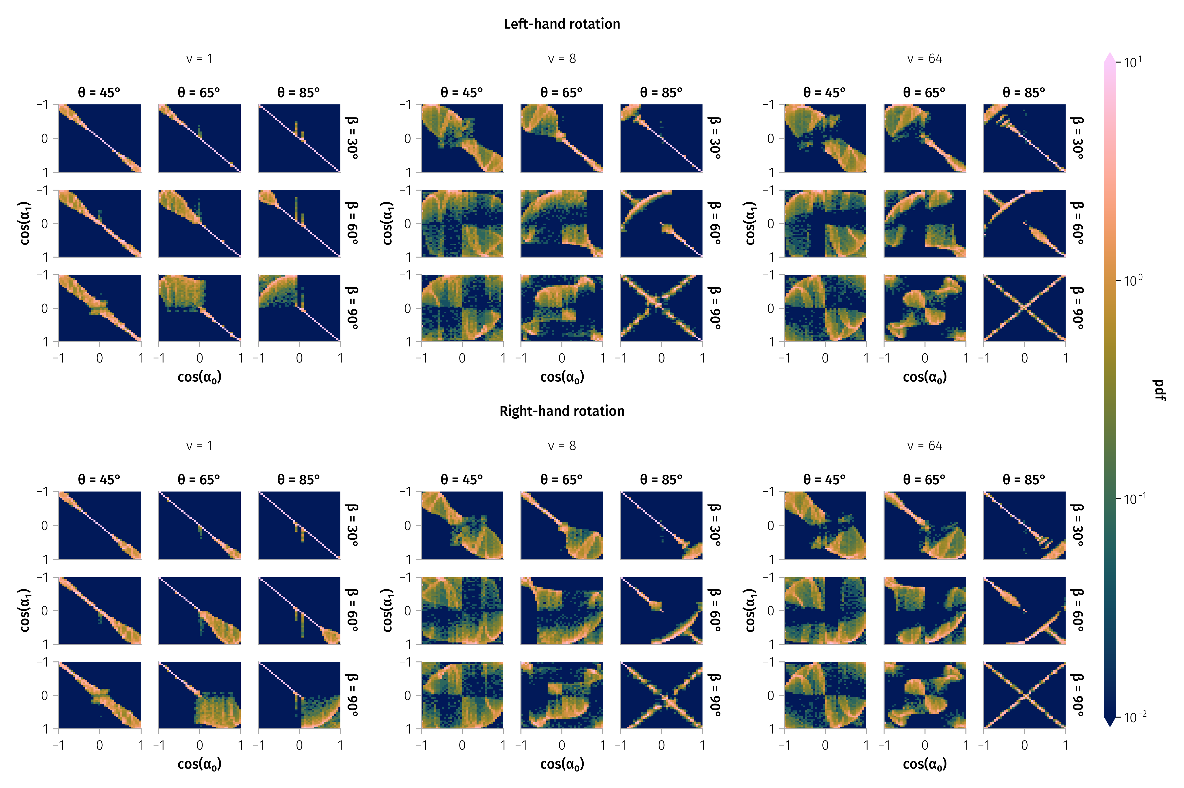
Examples of transition matrix

Slide 11
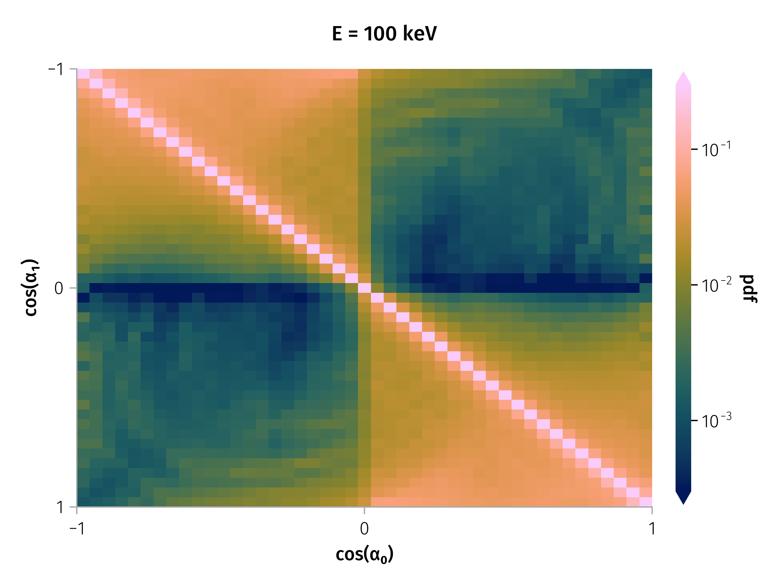
Transition matrix
Transition matrix for 100 keV particles.

Slide 12
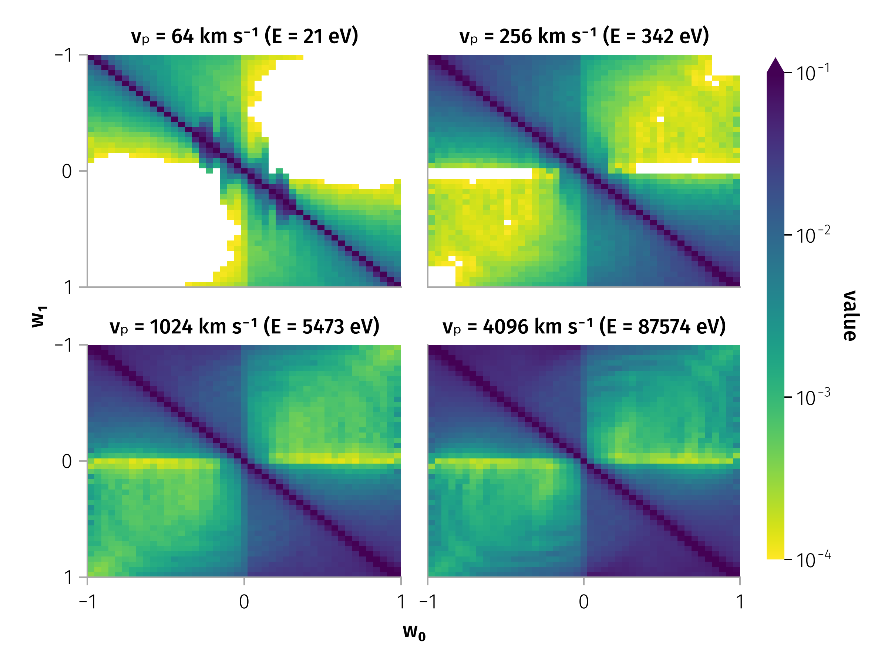
Transition matrix for different particle energies

Slide 13
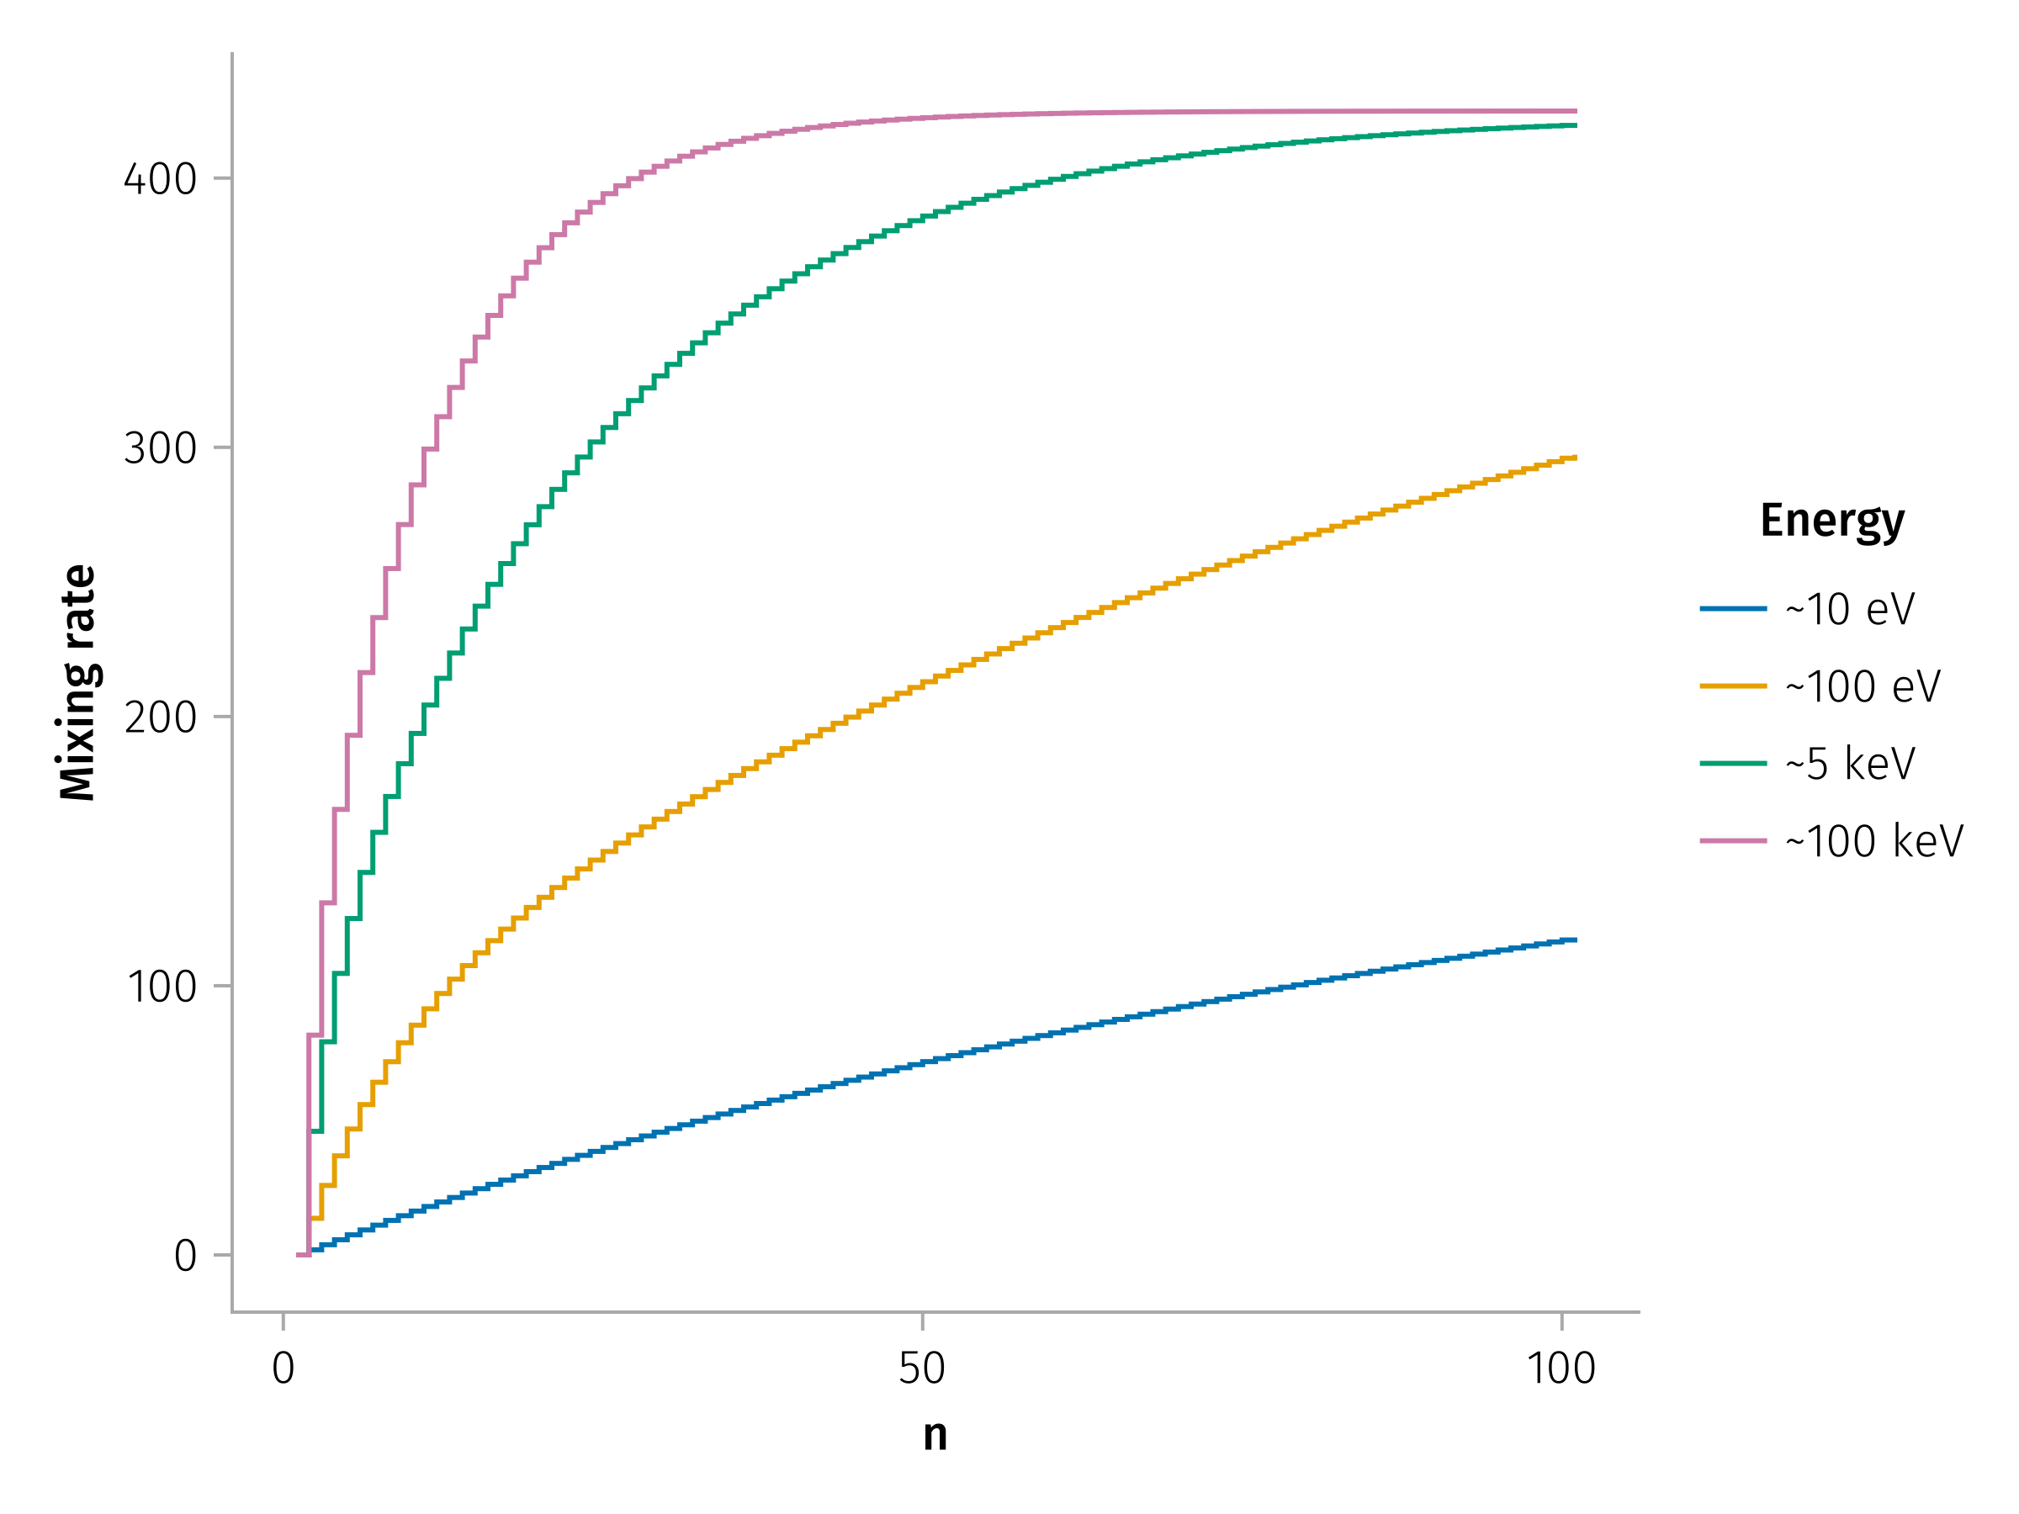
Mixing rates

Slide 14
References
Artemyev, A. V., A. I. Neishtadt, A. A. Vasiliev, V. Angelopoulos, A. A. Vinogradov, and L. M. Zelenyi. 2020. “Superfast Ion Scattering by Solar Wind Discontinuities.” Physical Review E 102 (3): 033201. https://doi.org/10.1103/PhysRevE.102.033201.
Moraal, H. 2013. “Cosmic-Ray Modulation Equations.” Space Science Reviews 176 (1): 299–319. https://doi.org/10.1007/s11214-011-9819-3.

