Slide 1
Spatial Evolution of Solar Wind Discontinuities in the Outer Heliosphere: JUNO and 1AU-missions Observations
Zijin Zhang Anton V. Artemyev Vassilis Angelopoulos

Slide 2
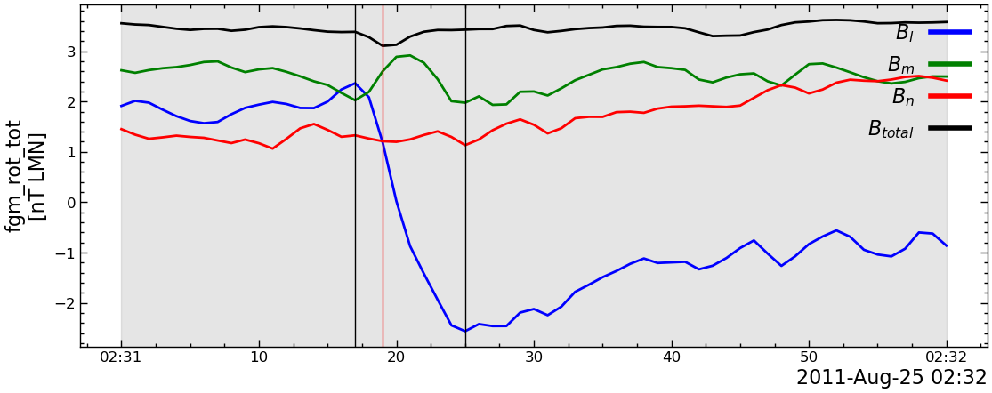
Introduction
Discontinuous changes in plasmas parameters and magnetic ﬁelds
Figure 1: Examples of IDs from ARTEMIS
Colburn et al., 1966
Figure 2: Examples of IDs from JUNO at different AU

Slide 3
Motivation
How do solar wind discontinuities evolve over radial distances from the Sun?
Juno during its five-year cruise phase (2011-2016) to Jupiter provides a unique opportunity!
=> What are the physical mechanisms behind their formation and evolution?

Slide 4
Overview
Figure 2: Overview. a, Juno’s orbit during its cruise phase (2011-2016). b, Difference in heliographic longitude between Juno and 1-AU missions. c, monthly and smoothed sunspot numbers.
Notes:
During the initial phase of the JUNO mission, the sunspot number reached its peak, indicating a period of heightened solar activity. However, by the end of the mission’s cruise phase, there was a significant decline in solar activity. This variation underscores the importance of calibrating the discontinuity properties in relation to solar activity levels to account for temporal fluctuations.

Slide 5
Temporal variations of SWDs
Figure 3: Distribution of various properties of IDs observed by Wind mission grouped by the year of observation. Panel (a) thickness, (b) normalized thickness, (c) current density, (d) normalized current density.

Slide 6
Figure 4: Solar wind parameters associated with the IDs observed by 1AU satellites (Wind, ARTEMIS and STEREO-A) grouped by the year of observation. Panel (a) solar wind density, (b) magnetic field, (c) fitted magnetic field amplitude.

Slide 7
Grouped by month for the year 2013
Notes:
The change in the current density could be explained by the change in the solar wind properties with the solar cycle, as shown in @fig-swParameters. Density and magnetic field asscoiated with the discontinuities increases with the solar cycle approaching the solar minimum, which could lead to the increase of the current density of the discontinuities with fixed normalized current density.

Slide 8
Grouped by week for the first two months of 2013

Slide 9
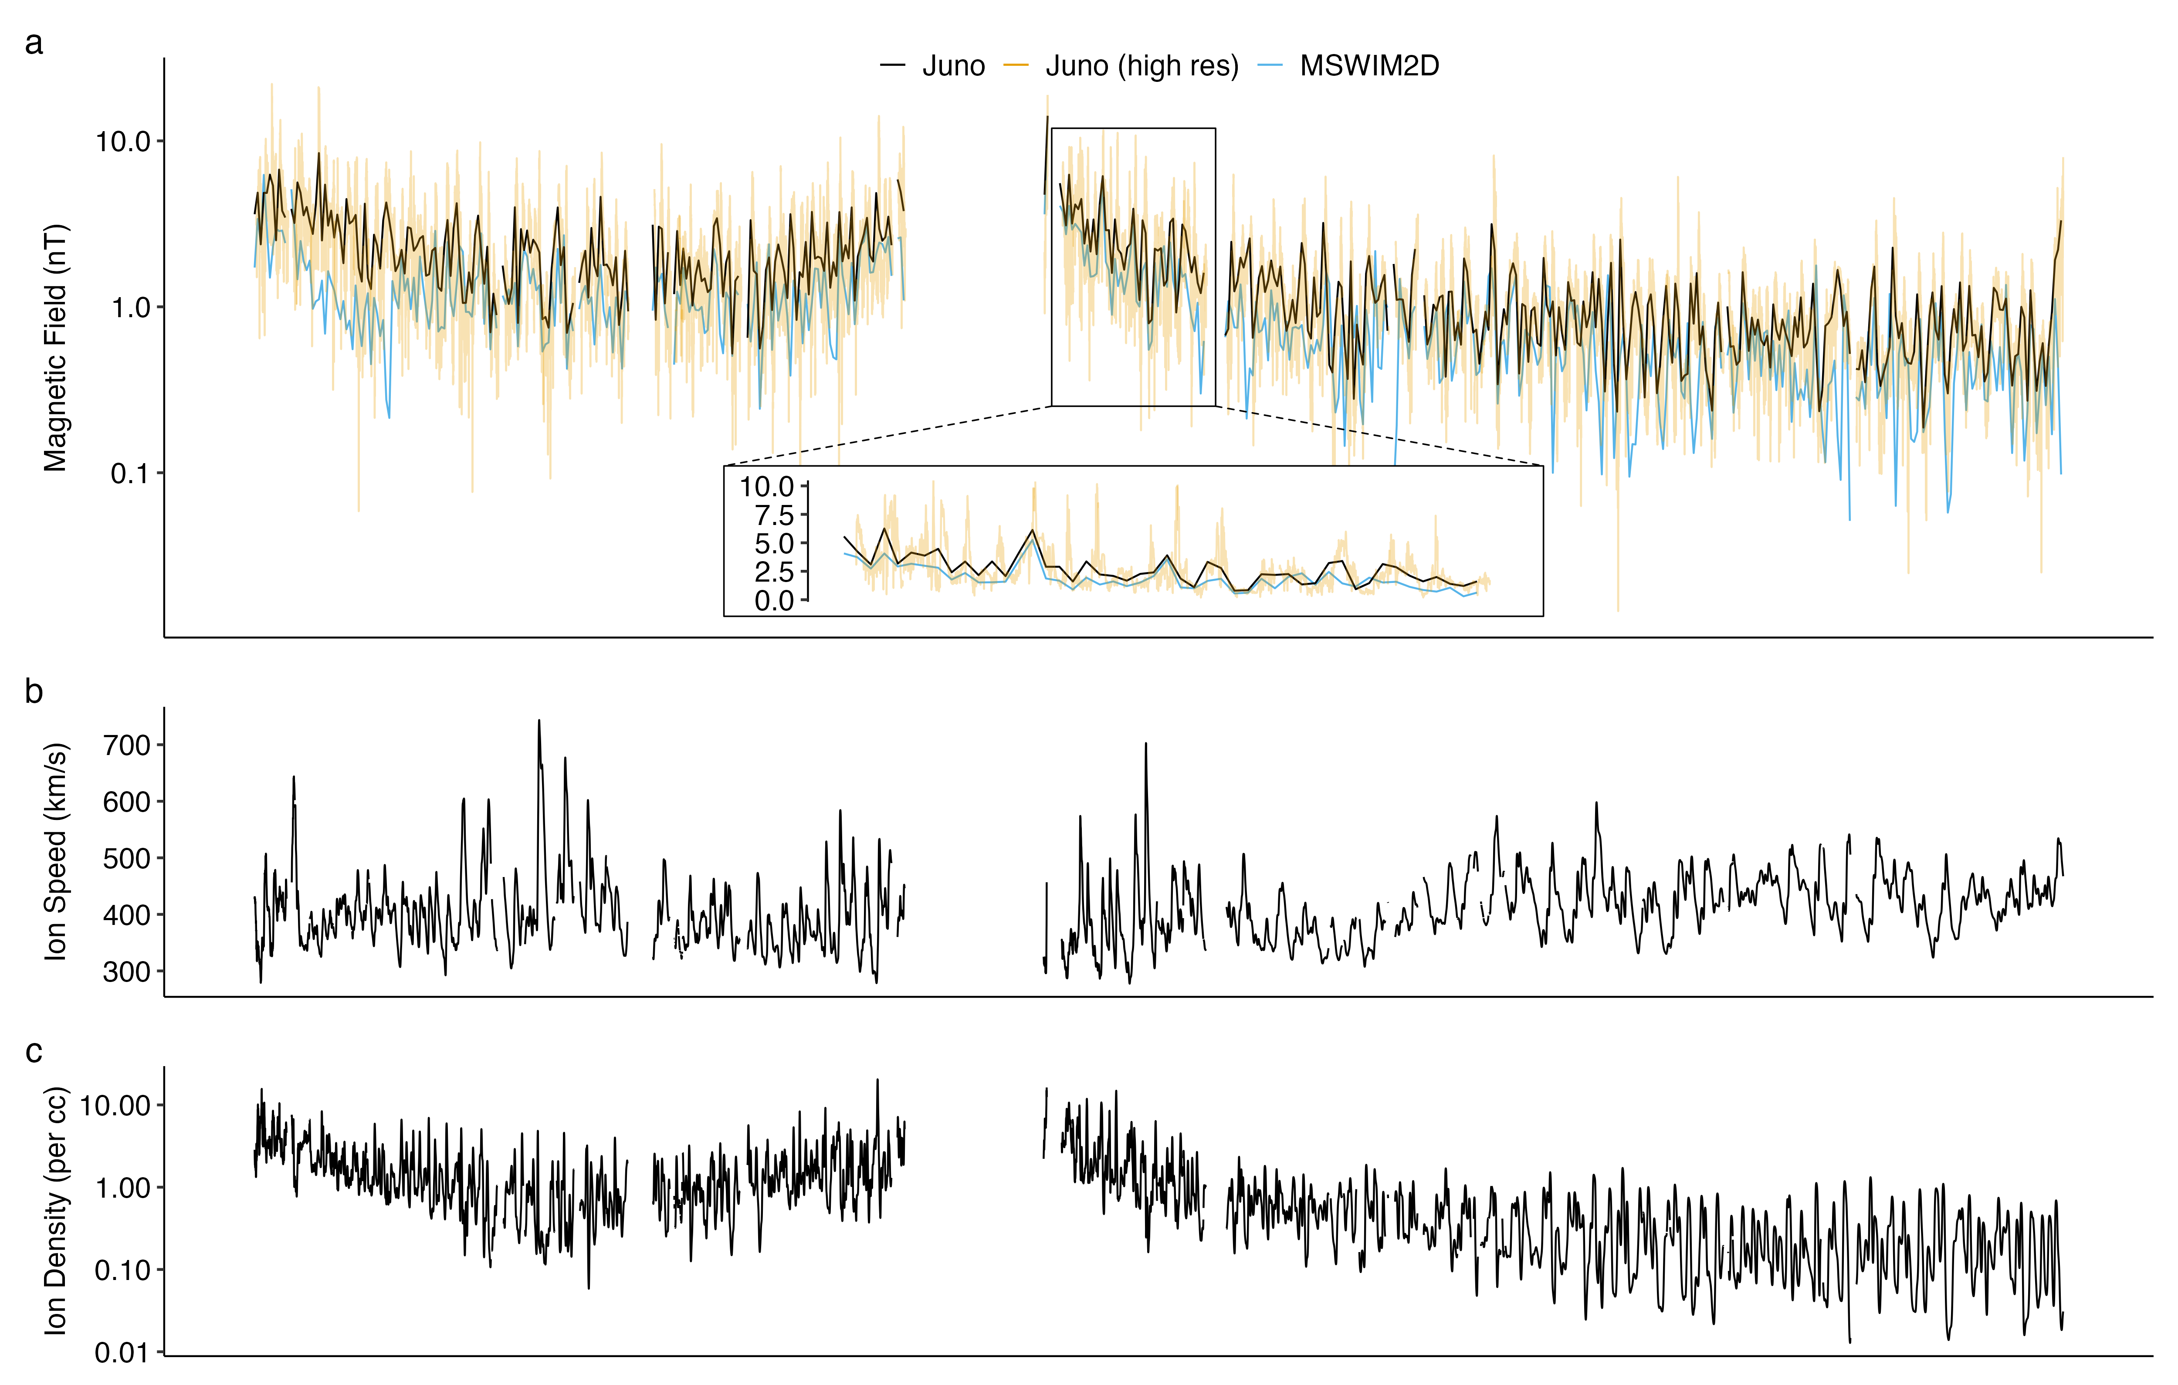
Dataset
Mission | δt(B) | δt(plasma)
Juno | 1 Hz | 1 hour
ARTEMIS | 5 Hz | 0.25 Hz
WIND | 11 Hz | 1 Hz
STEREO | 8 Hz | 1 min
Figure 5:
a, Magnetic field magnitude from MSWIM2D and Juno.
b-c, Plasma speed and density from MSWIM2D model.
Notes:
However, since Juno does not provide direct plasma measurements, we will estimate the spatial scale (thickness) of discontinuities using solar wind speed derived from solar wind propagation models. Specifically, we will employ the Two-Dimensional Outer Heliosphere Solar Wind Modeling (MSWIM2D) (Keebler et al. 2022) to determine the ion bulk velocity (v) and plasma density (n) at Juno’s location. This model, which utilizes the BATSRUS MHD solver, simulates the propagation of solar wind from 1 to 75 astronomical units (AU) in the ecliptic plane, effectively covering the region pertinent to our study. The MSWIM2D model provides output data with an hourly time resolution as shown in Figure 5. The comparison of magnetic field magnitudes from MSWIM2D with those measured by Juno, after averaging to the same time resolution, reveals a strong correlation, confirming the model’s reliability.

Slide 10
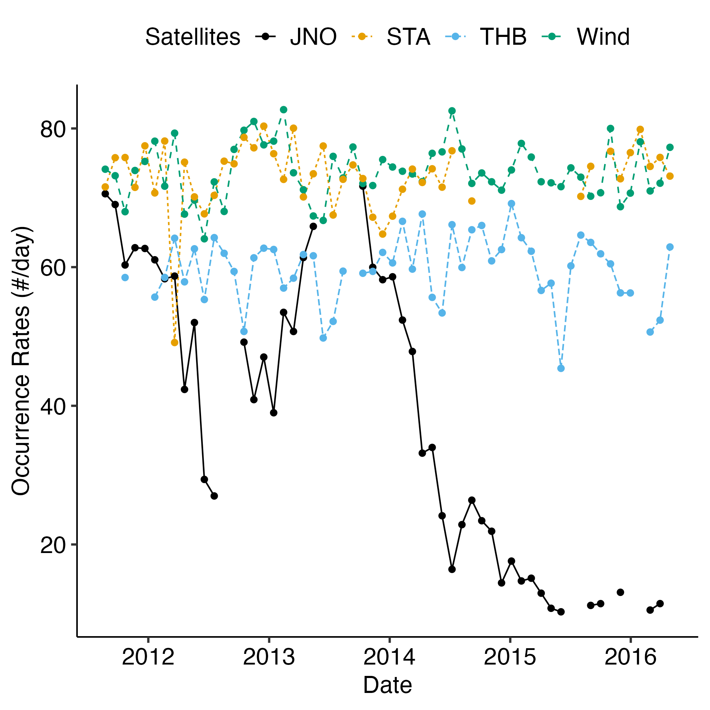
Results - Occurrence rate
Figure 6: The number of discontinuities measured by Juno per day coincides with the discontinuity number measured by STEREO, WIND, and ARTEMIS, when Juno is around $1$ AU. This number (occurrence rate) decreases with distance (with time after $∼2013$), as Juno moves from $1$ AU to $5$ AU.

Slide 11
Results - Current density and thickness
Figure 7: Distribution of various properties of IDs observed by Juno grouped by the radial distance from the Sun. Panel (a) thickness, (b) normalized thickness, (c) current density, (d) normalized current density.

Slide 12
Conclusion
The normalized occurrence rate of interplanetary discontinuities (IDs) decreases with radial distance from the Sun, following a $1/r$ relationship.
The thickness of IDs increases with radial distance, but when normalized to the ion inertial length, it decreases.
The current density of IDs decreases with radial distance, but when normalized to the Alfvén current, it increases.
The distribution of the normalized thickness and current density of IDs remain constant over time at 1 AU on a yearly scale.

Slide 13
References
Keebler, Timothy B., Gábor Tóth, Bertalan Zieger, and Merav Opher. 2022. “MSWIM2D: Two-Dimensional Outer Heliosphere Solar Wind Modeling.” Astrophysical Journal Supplement Series 260 (2): 43. https://doi.org/10.3847/1538-4365/ac67eb.

